Slide 1
A Fast and Practical Bit-Vector Algorithm for the Longest Common Subsequence Problem
Maxime Crochemore a, Costas S. Iliopoulos b,c, Yoan J. Pinzonb,∗, James F. Reid b,d
Received 2 February 2001; received in revised form 9 March 2001
Communicated by L. Boasson
Information Processing Letters 80 (2001) 279–285
Presenter: Mao-Yuan Kao
Date: Jun. 29, 2006

Slide 2
Abstract
This paper presents a new practical bit-vector algorithm for solving the well-
known Longest Common Subsequence (LCS) problem. Given two strings of
length m and n, n ≧ m, we present an algorithm which determines the length p
of an LCS in O(nm/w) time and O(m/w) space, where w is the number of bits
in a machine word. This algorithm can be thought of as column-wise
“parallelization” of the classical dynamic programming approach. Our
algorithm is very efficient in practice, where computing the length of an LCS
of two strings can be done in linear time and constant (additional/working)
space by assuming that m ≦ w.

Slide 3
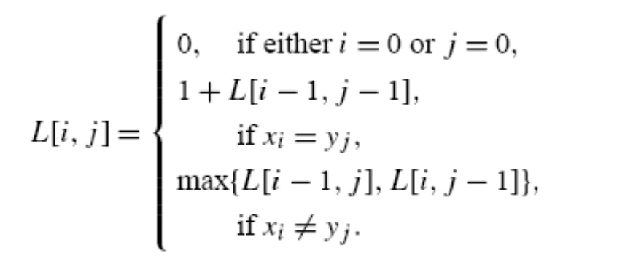
Longest Common Subsequence
Let the two input strings be x = x₁ ···x_{m} and y =y₁ ···y_{n} and let L[i, j ] denote the
length of an LCS (LLCS) for the prefixes x₁ ···x_{i} and y₁ ···y_{j}.

Slide 4
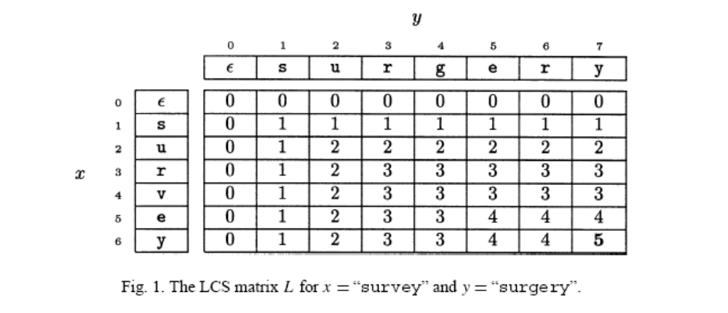
Longest Common Subsequence (cont.)
Fig. 1 shows the computation of the matrix L for x = “survey” and y = “surgery”.
The LLCS p for this example is L[6, 7] = 5 and LCS w = “surey”.

Slide 5
k-dominant matches
Many algorithms for the LCS have used the so-called k-dominant matches.
The ordered pair of positions i and j of L, denoted [i, j ], is a match iff xi = yj .
If [i, j ] is a match, and an LCS w_{i,j} of x₁x₂ ···x_{i} and y₁y₂ ···y_{j} has length k, then k
is the rank of [i, j ]. The match [i, j ] is k-dominant if it has rank k and for any
other pair [i, j] of rank k, either i’ > i and j’ ≦ j or I’ ≦ i and j’ > j.

Slide 6
Chain and Antichain
A match [i, j ] precedes a match [i’, j’] if i < i’ and j < j’. Let R denote this
partial order relation on the set of matches in L.
A set of matches such that in any pair one of the matches always precedes the
other in R constitutes a chain relative to the partial order relation R.
A set of matches such that in any pair neither element of the pair
precedes the other in R constitutes an antichain.
the LCS problem translates to finding a longest chain in the
poset of matches induced by R.

Slide 7
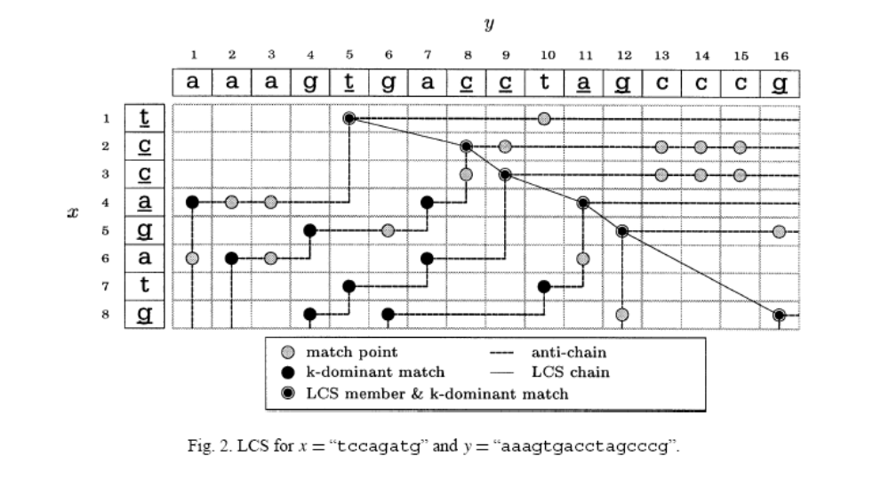
The computation of the LCS for x = “tccagatg” and y = “aaagtgacctagcccg” is depicted in Fig. 2.
The chain from L[1, 5] to L[8, 16] spells out the LCS w = “tccagg”.

Slide 8
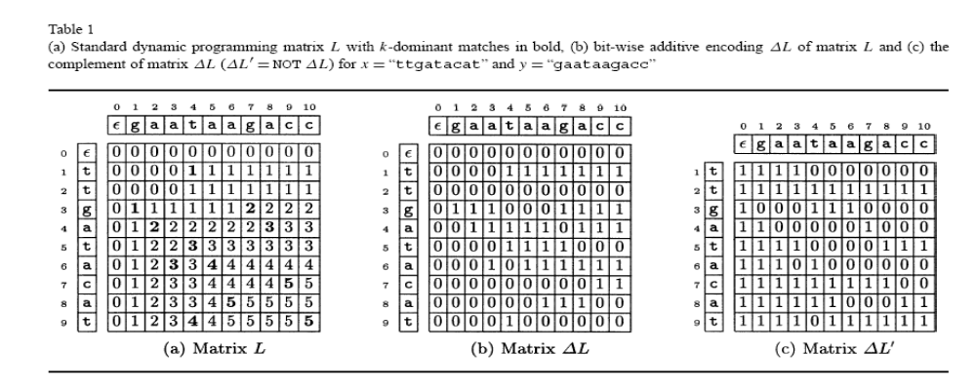
A simple bit-vector algorithm
We will denote by ΔL the relative encoding of the table L, i.e.,
ΔL[i, j] = L[i, j] − L[i − 1, j] ∈ {0, 1} for any (i, j ) ∈ {1..m}×{1..n}. Table 1
shows the table L and the corresponding ΔL table for x = “ttgatacat” and y =
“gaataagacc”. We also define ΔL’ as the negation of ΔL (ΔL = NOT ΔL).

Slide 9
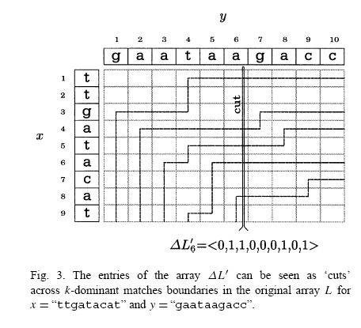
A simple bit-vector algorithm (cont.)
Fig. 3 illustrates how to obtain ΔL’6 by drawing a vertical line (that we called
‘cut’) at position 6 and we define ΔL’6[i] = 0 iff the boundary line of k-
dominant matches passes at this position and 1 otherwise.

Slide 10
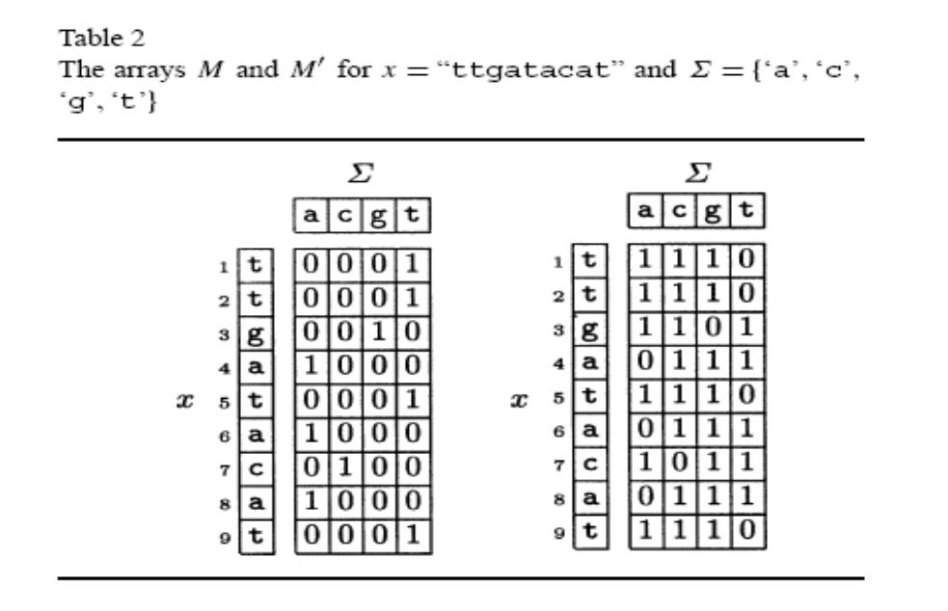
A simple bit-vector algorithm (cont.)
The basic steps of the algorithm are as follows:
(1)First we compute the array M of the vectors that result for each possible
text character. If both the strings x and y range over the alphabet Σ then M[Σ]
is defined as M[α]_{i} = 1 if x_{i} = α Otherwise 0. This results in having a bit-
vector associated to each symbol in the alphabet Σ.
We also define the array M’ as the negation of M
.

Slide 11
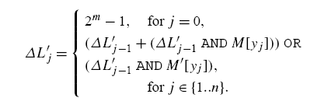
A simple bit-vector algorithm (cont.)
(2) Let y_{j} =α be the symbol being scanned in the string y at iteration j.
Let M[α] _{1:m} and M’[α] _{1:m} be the vectors resulting from the previous
step on the symbol y_{j} = α. Let ΔL_{j-1} be the bit-vector column of length
m of the table ΔL’ computed at the previous iteration j − 1. We obtain
the new column ΔLj using the following recursive formula:

Slide 12
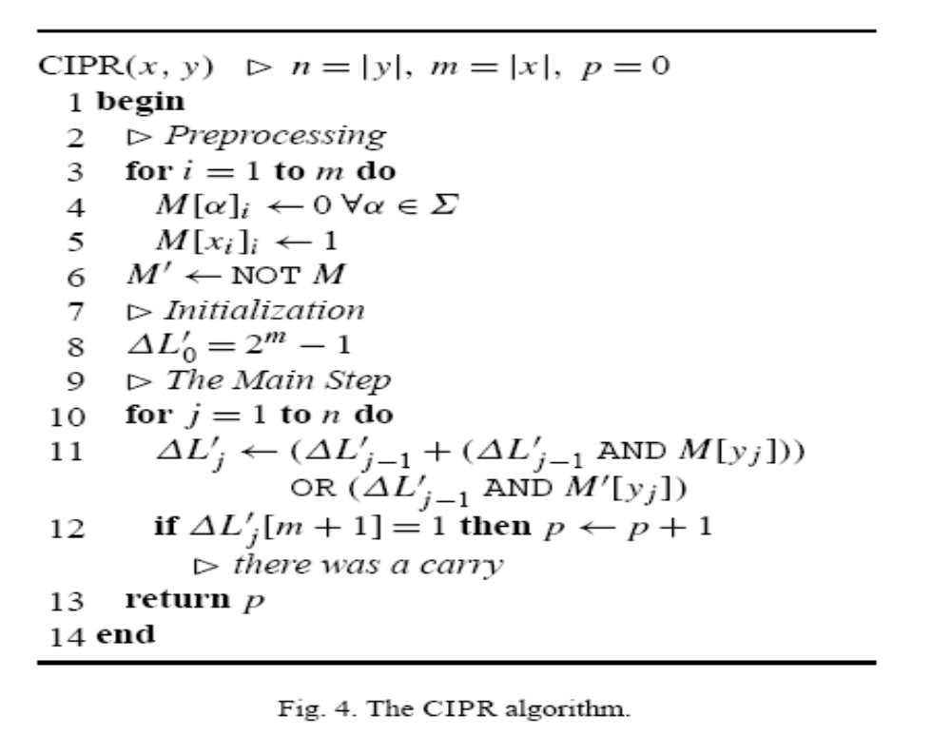
A simple bit-vector algorithm (cont.)
(3) Let LLCS be the number of times that a carry took place
when computing ΔL_{j} in the previous step.

Slide 13


A simple bit-vector algorithm (cont.)
The formula in the second step can be performed in O(m/w) since the
three bit-wise operation in the formula (AND, OR, and AND) and the
Addition operation can be done in O(m/w) time.
Our problem can also be seen as an automaton where the states are the
columns of ΔL matrix and the transition functions depends on the
previous state and the preprocessing for the symbol being scanned, i.e.,
Strictly speaking

Slide 14
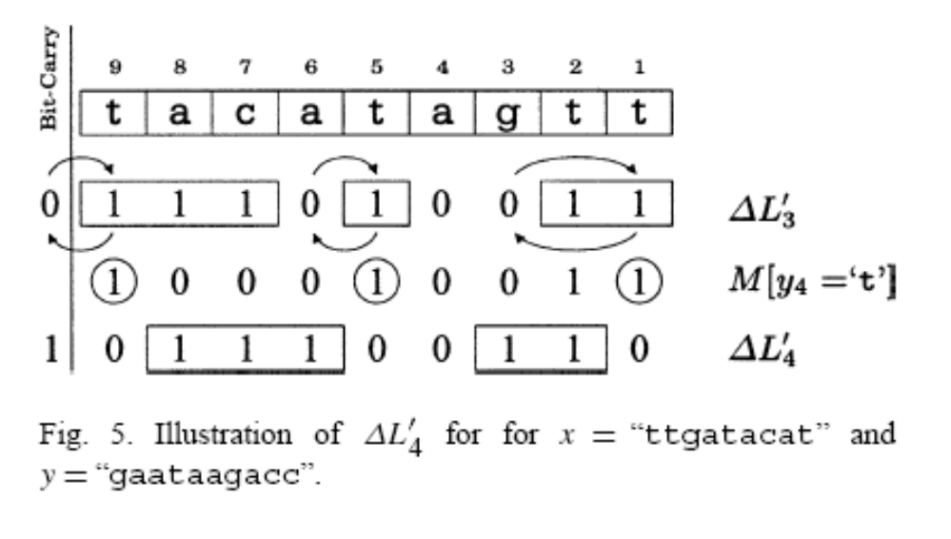
A simple bit-vector algorithm (cont.)
First step we want to select the right-most bit in M[y_{j} ] for each block of 1’s in ΔL_{j−1} (see the circled numbers in Fig. 5).
The second step involves swapping each of the selected bits with the closest 0 to the left in ΔL_{j−1}. In other words, the first step selects the matches that are candidates to update a current k-dominant match (0 bits in the previous state) and the second step updates them by just swapping the two.
Fig. 5 illustrates the computation of ΔL₄’ using the previous state ΔL₃’ and the preprocessing array for the symbol y₄ = ‘t’ found in M[‘t’]. Computing the transition function f consists of two steps.

Slide 15
A simple bit-vector algorithm (cont.)
In the first place, those matches in positions where there is a k- dominant
match currently must be set off. This is obtained by and-ing L_{j−1} with M[y_{j} ].
From our example, 111010011 AND 100010011= 100010011.
Now we want to select only the right-most bit among each block of 1’s and
swap it with the closest 0 on its left. This is obtained by using the addition
operation, which will change the left most bit for 0 and propagate this bit until
a zero is found, i.e., a k-dominant match to be updated.
For example, 111010011+ 100010011= 011100110
with a bit-carry.

Slide 16
A simple bit-vector algorithm (cont.)
However, as you can see during the process there are cases where more than 1
bit is set off and we only want the right-most bit to be set off.
This problem can be corrected by or-ing what we have so far with
(ΔL’_{j−1} AND M’[y_{j} ]).
This has the effect of correcting the bits that were set off during the addition.
for example, 011000000 OR 011100110= 011100110,
which is exactly what we wanted to get, i.e., ΔL4.
=>O(nm/w)

